Slide 1

Fake News Detection
Hemalatha Subbiah

Slide 2

Fake News
Fake news is sometimes transmitted through the internet by some unauthorized sources, which creates issues for the targeted person, and it makes them panic and leads to even more violence. To combat the spread of fake news, it’s critical to determine the information’s legitimacy, which this project can help with. This project is relevant to the media industry, news outlets, and social media platforms that are responsible for sharing news articles. Classifying news articles as real or fake can help these organizations improve their content moderation and reduce the spread of fake news.
.

Slide 3

The Problem Statement
This project aims to classify news articles as real, or fake based on their content. Specifically, this project will use machine learning to build a model to predict whether a given news article is real, or fake based on its text.
How Machine Learning Can Be Used?
Regression or Classification models can be built to predict the Air Quality index based on the Pollutant Concentration levels.
Effects of interactions between the variables and linear and non-linear relationship patterns between the variables can be studied.
Data can be processed in real-time to alert the authorities and issue warnings to the public in extreme cases to avoid a certain area due to poor air quality.

Slide 4
Source of the Data The Data files are from Kaggle website. Various Datasets each containing the concentration of pollutants, gases, and meteorological parameters for the year 2022 are used in the study.
A fake news dataset typically comprises a collection of articles, social media posts, or other textual content that is labeled as either true or false. These datasets are used to train and evaluate machine learning models for detecting misinformation. They often include various features such as the text of the content, metadata, and user interactions. Creating and maintaining such datasets involves significant challenges, such as ensuring the accuracy of labels, addressing the evolving nature of fake news, and addressing privacy concerns related to the data used. These datasets are crucial for advancing research and developing more effective fake news detection systems. Dataset separated in two files:
Fake.csv (23502 fake news article)
True.csv (21417 true news article)
Dataset columns:
1. Title: Title of news article
2. Text: Body text of news article
3. Subject: Subject of news article
4. Date: Publish date of news article

Slide 5

Fake News
Fake news is sometimes transmitted through the internet by some unauthorized sources, which creates issues for the targeted person, and it makes them panic and leads to even violence. To combat the spread of fake news, it’s critical to determine the information’s legitimacy, which this project can help with. This project is relevant to the media industry, news outlets, and social media platforms that are responsible for sharing news articles. Classifying news articles as real or fake can help these organizations improve their content moderation and reduce the spread of fake news.
.

Slide 6
Source of the Data The Data files are taken from the Environmental Protection Agency (EPA) website. Various Datasets each containing the concentration of pollutants, gases, and meteorological parameters for the year 2022 are used in the study.
Fake news is sometimes transmitted through the internet by some unauthorized sources, which creates issues for the targeted person, and it makes them panic and leads to even violence. To combat the spread of fake news, it’s critical to determine the information’s legitimacy, which this project can help with. This project is relevant to the media industry, news outlets, and social media platforms that are responsible for sharing news articles. Classifying news articles as real or fake can help these organizations improve their content moderation and reduce the spread of fake news.
.

Slide 7
Steps Involved in this Project
In the first step, the source of the data will be identified
The data is then explored to identify the patterns and relationships between the variables.
01
Data Collection
02
Data Exploration
In this step data cleansing such as duplicate checks, null handling, and feature selections are done. The datasets are also merged.
In this step, the dataset will be split into train and test sets and the models will be trained using R and Python.
Data Cleansing & Preparation
Model Building in R
And Python
03
04
The Model results along with the chosen metrics will be analyzed and the best model will be chosen.
Analyzing the Model outcome
05
06
Results
The final results will then be published.

Slide 8
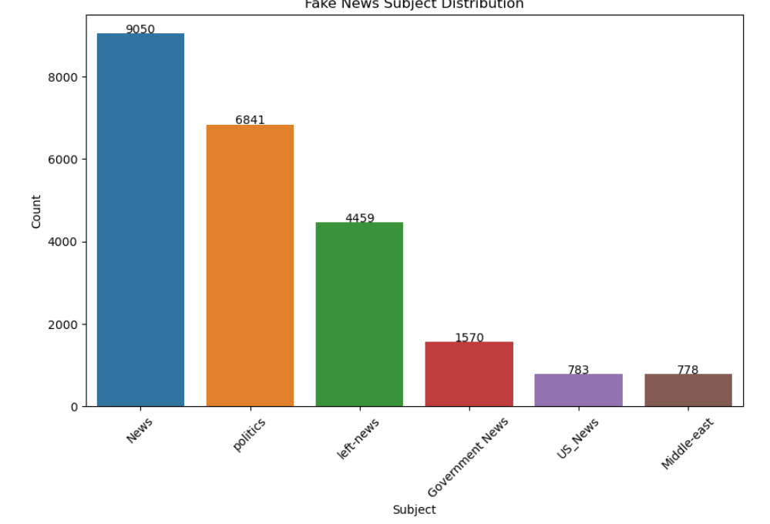
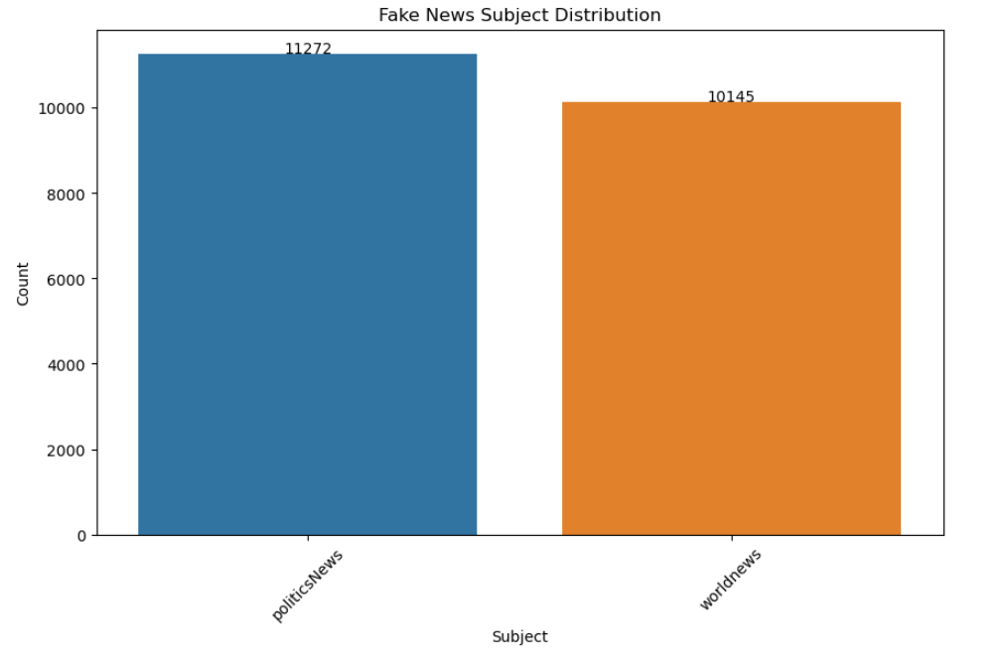
Data Exploration
The Histogram indicates fake news subject distribution of subject titles and count.
The Histogram indicates real news subject distribution of subject titles and count.
.

Slide 9
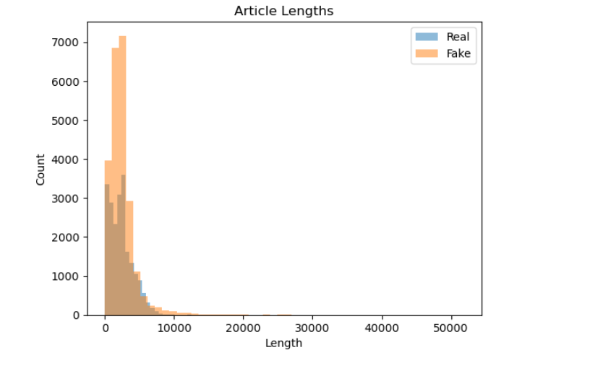
Data Exploration
The Bar plot indicates the article length of real and fake news.The length of the articles is highly variable, with some articles being very short (less than 1000 characters) and others being quite long (more than 40,000 characters). We will need to take this into account when preprocessing the text

Slide 10
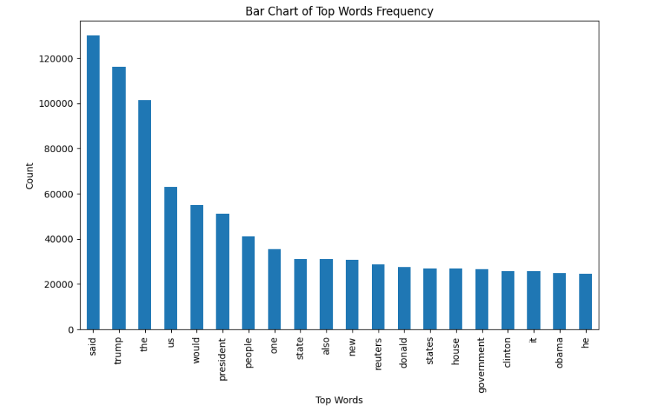
Data Exploration
The Bar graph plot for top 20 most frequent words.

Slide 11
The Process of Data Preparation
Lowercasing the text and removing punctuation and digits.
Count Vectorizer transforms a collection of text documents into a matrix of word counts.
Created a Count Vectorizer object and fitted it to the preprocessed text in the real news dataset and then used the same vectorizer to transform the preprocessed text in the fake news dataset and stacked the feature matrices for both datasets vertically and create a corresponding label vector, y.
Removing stop words and Stemming or lemmatizing the text

Slide 12

Model Building in Python
Multiple Regression models were built in Python using algorithms such as
Logistic Regression
Decision Tree Regression
Random Forest Regression
SVC
Multinomial
Feature and label vectors, are split the data into training and testing sets.
Count Vectorizer converts a collection of text documents into a matrix of token counts. It works by first tokenizing the text into words and then counting the frequency of each word in each document. The resulting matrix can be used as input to machine learning algorithms for tasks such as text classification.
Metrics such as Accuracy ,Precision, Recall and F1 Score were used to evaluate the model performance.

Slide 13
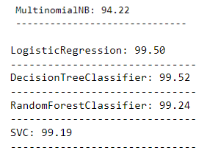
Model Building in Python (Contd)
The Regression model results were better with the Random Forest Regressor and Gradient Boost Algorithms regarding R2 statistic.
Implemented Hyperparameter tuning of the logistic regression model using methods such as grid search or randomized search to find the optimal set of parameters for our dataset.
The models returned accuracy results using the PCA Feature reduction method

Slide 14

Model Outcome and Conclusion
The model results predicts the news as Real or Fake.
Converts a collection of text documents to a matrix of token counts, which can then be used as input for machine learning algorithms. The choice of a machine learning algorithm can significantly impact the performance of a text classification task. In this project, we compared the performance of logistic regression, decision tree, random forest and support vector machines and found that logistic regression had the best performance

Slide 15

Ethical Concerns
Ethical considerations in fake news detection include balancing freedom of speech with preventing misinformation, avoiding excessive censorship, and mitigating algorithmic biases to ensure fairness and transparency. Privacy concerns must be addressed, requiring informed user consent for data collection. Accuracy is crucial, minimizing false positives and negatives by using reliable sources. Clear accountability and robust governance are necessary, along with transparency to maintain public trust. Education and empowerment through media literacy and verification tools are essential. Global sensitivity to cultural differences and international collaboration, respecting diverse legal and ethical standards, is also important.
. Limitations:
Building a fake news detection model faces several limitations, including data Issues inaccurate labels, dataset bias, and data imbalance can mislead the model. Inadequate features, overfitting, and algorithmic biases can reduce effectiveness. Metrics like accuracy can be misleading, and improper cross-validation can skew performance estimates. Ethical misuse, the dynamic nature of fake news, interpretability issues, and scalability challenges impact the model's reliability and trustworthiness. Addressing these limitations requires careful data handling, robust model design, and ethical considerations.

Slide 16
References
https://www.kaggle.com/datasets/clmentbisaillon/fake-and-real-news-dataset
https://paperswithcode.com/dataset/liar

Slide 17

Thank you

